Slide 1
Ch 4. Combinational logic

Slide 2
4.1 Introduction

Slide 3
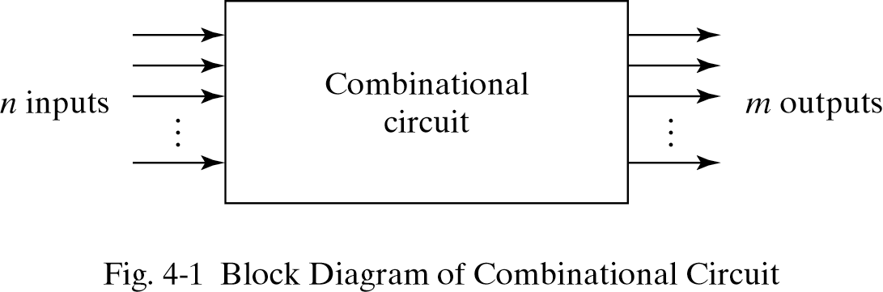
4.2 Combinational circuits
Outputs are determined from the present inputs
Consist of input/output variables and logic gates

Slide 4
4.3 Analysis procedure
To determine the function of circuit
Analysis procedure
  Make sure the circuit is combinational or sequential
  Obtain the output Boolean functions or the truth table

Slide 5
4.3 Analysis procedure
Boolean function
  Label all gate outputs
  Make output functions at each level
  Substitute final outputs to input variables
Truth table
  Put the input variables to binary numbers
  Determine the output value at each gate
  Obtain truth table

Slide 6
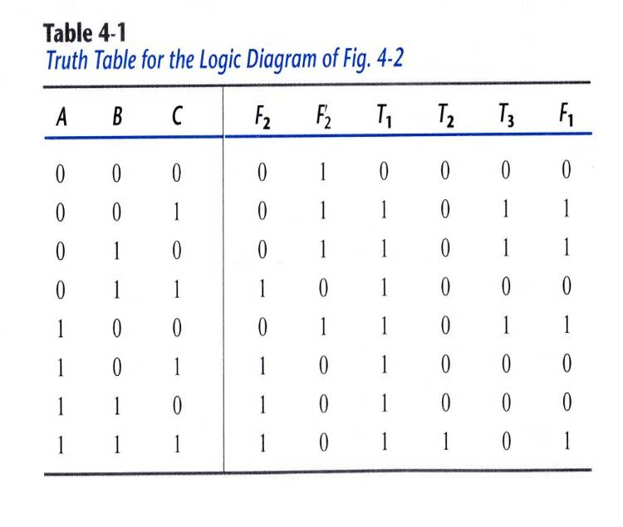
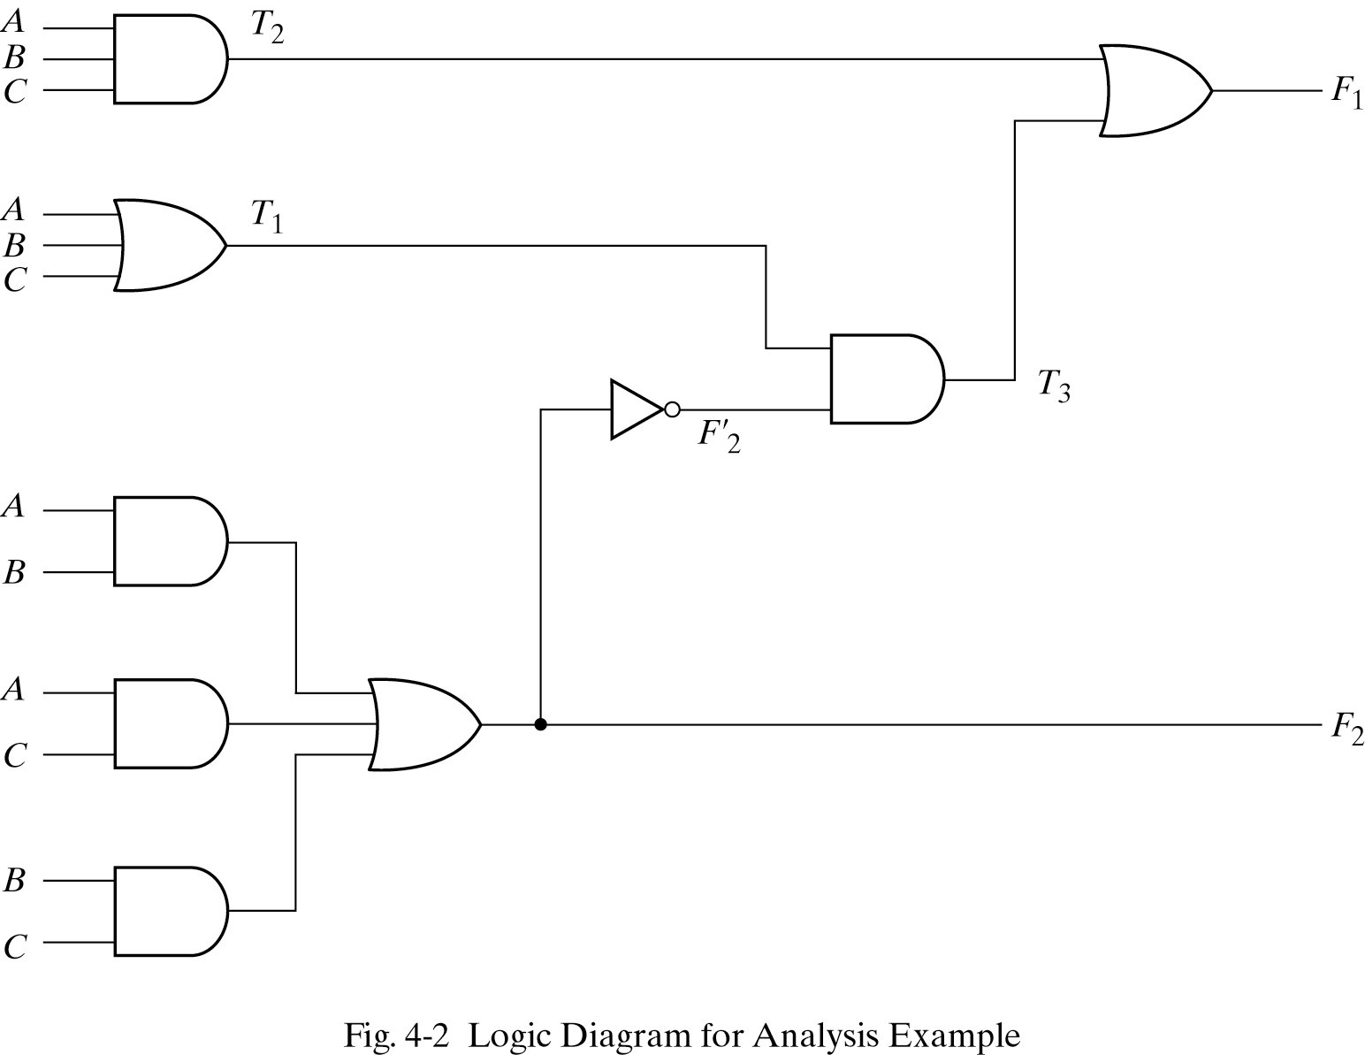
4.3 Analysis procedure

Slide 7
4.4 Design procedure
Procedure to design
  Determine the required number of input and output from specification
  Assign a letter symbol to each input/output
  Derive the truth table
  Obtain the simplified Boolean functions
  Draw the logic diagram and verify design correctness

Slide 8
4.4 Design procedure - Code conversion example
BCD to excess-3 code converter
  Excess-3 code : decimal digit+3
Design procedure
  1)Determine inputs/outputs
  Inputs : A,B,C,D (0000∼1001)
  Outputs : W,X,Y,Z (0011∼1100)

Slide 9
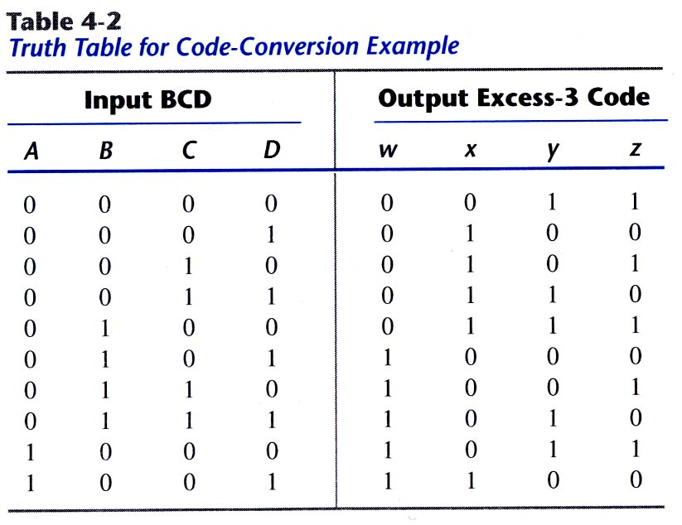
4.4 Design procedure - Code conversion example
2)Derive truth table

Slide 10
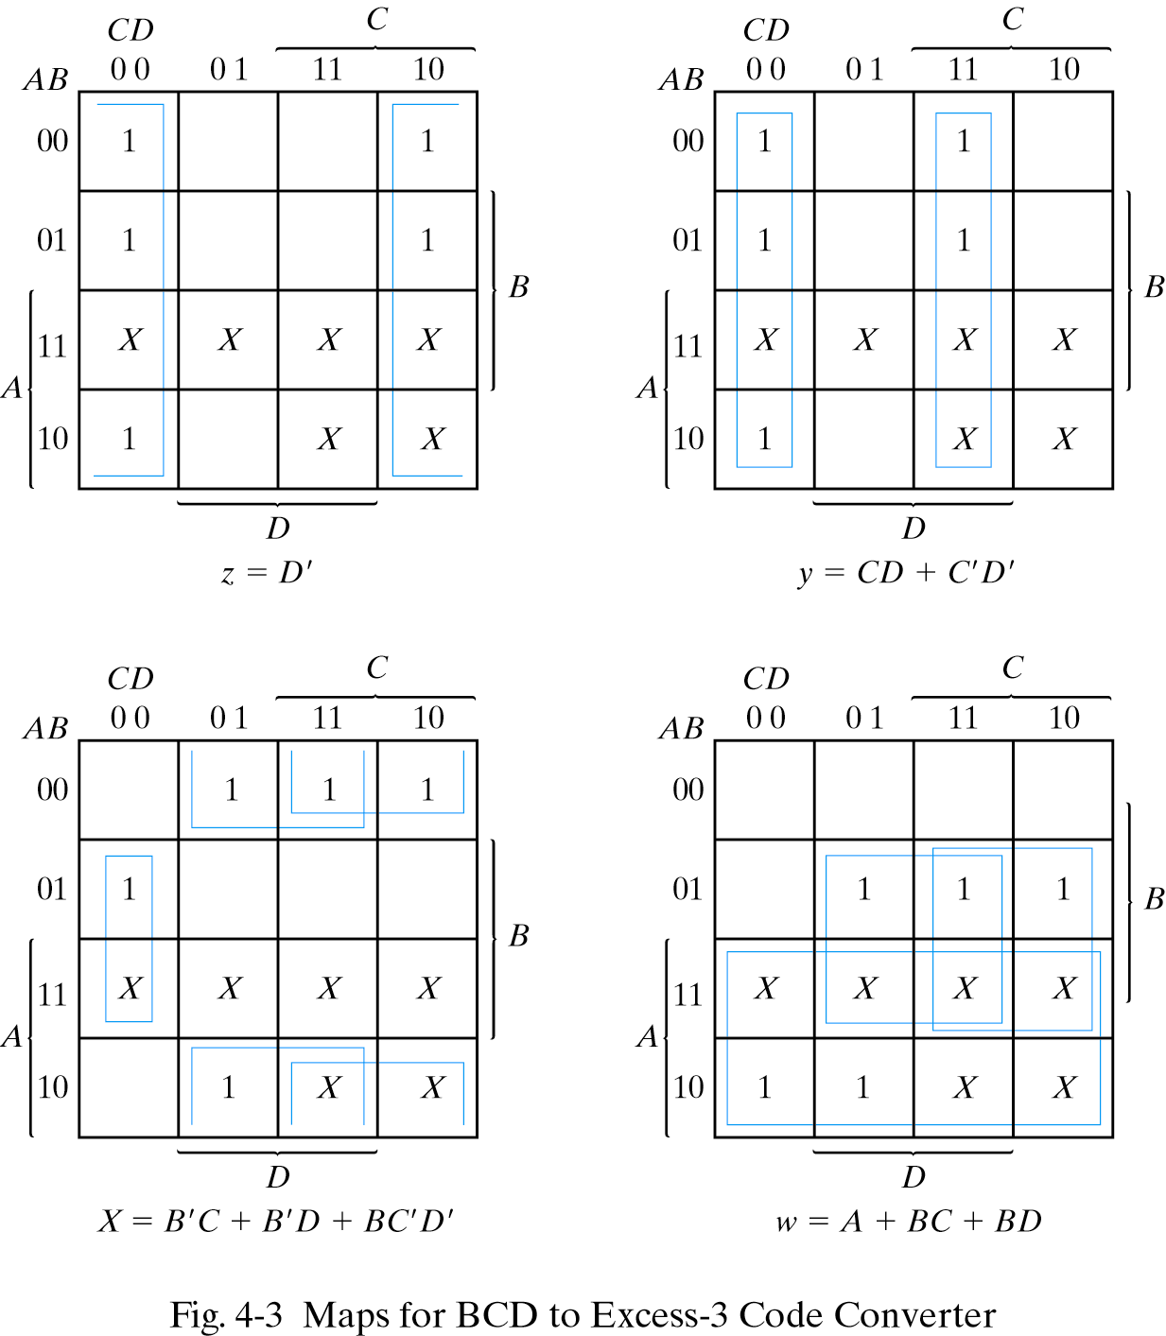
4.4 Design procedure - Code conversion example
3)Obtain simplified Boolean functions

Slide 11
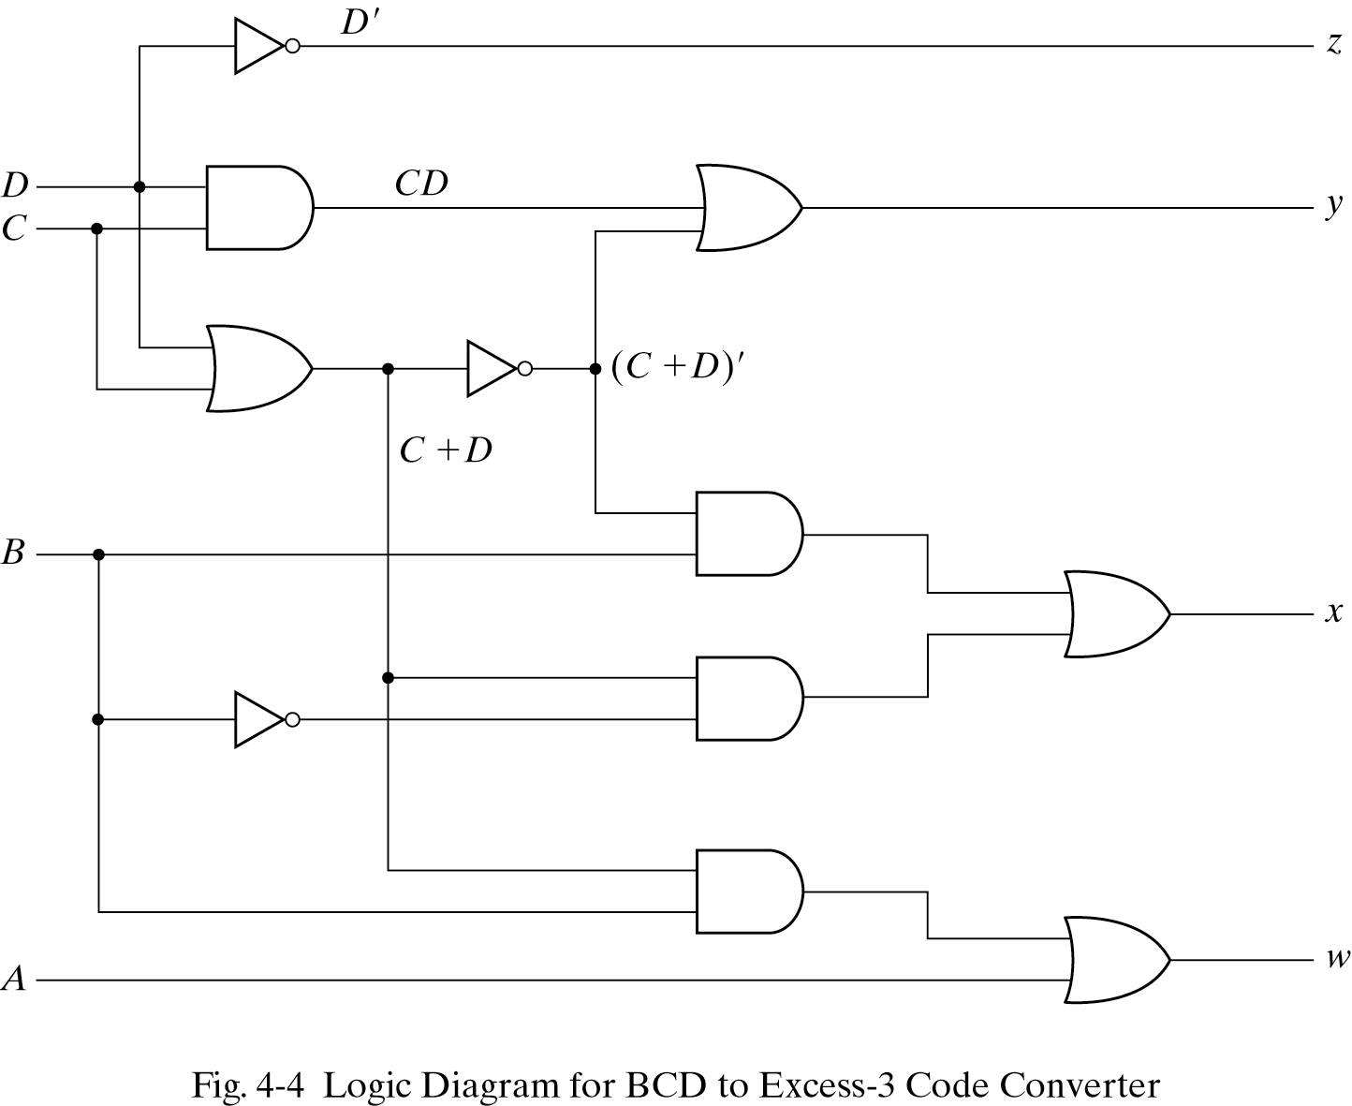
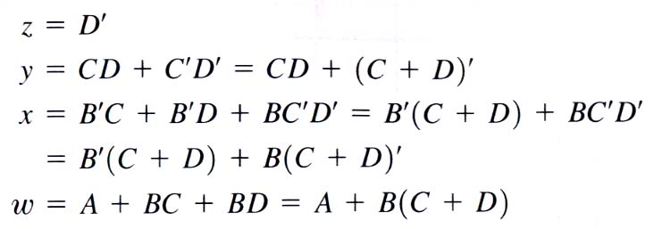
4.4 Design procedure - Code conversion example
4)Draw the logic diagram

Slide 12
4.5 Binary adder-subtractor
Binary adder
  Half adder : performs the addition of 2-bits(x+y)
  Full adder : performs the addition of 3-bits(x+y
  +z)
  Two half adder can be employed to a full adder
Realization of Binary adder-subtractor
  Half adder
  Full adder
  Cascade of n-full adder
  Providing a complementing circuit

Slide 13
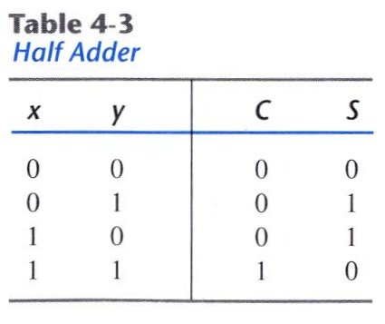
4.5 Binary adder-subtractor - Half Adder
Sum of 2 binary inputs
Input : X(augend), Y(addend)
Output : S(sum), C(carry)
  S=xy′+x′y
  C=xy

Slide 14
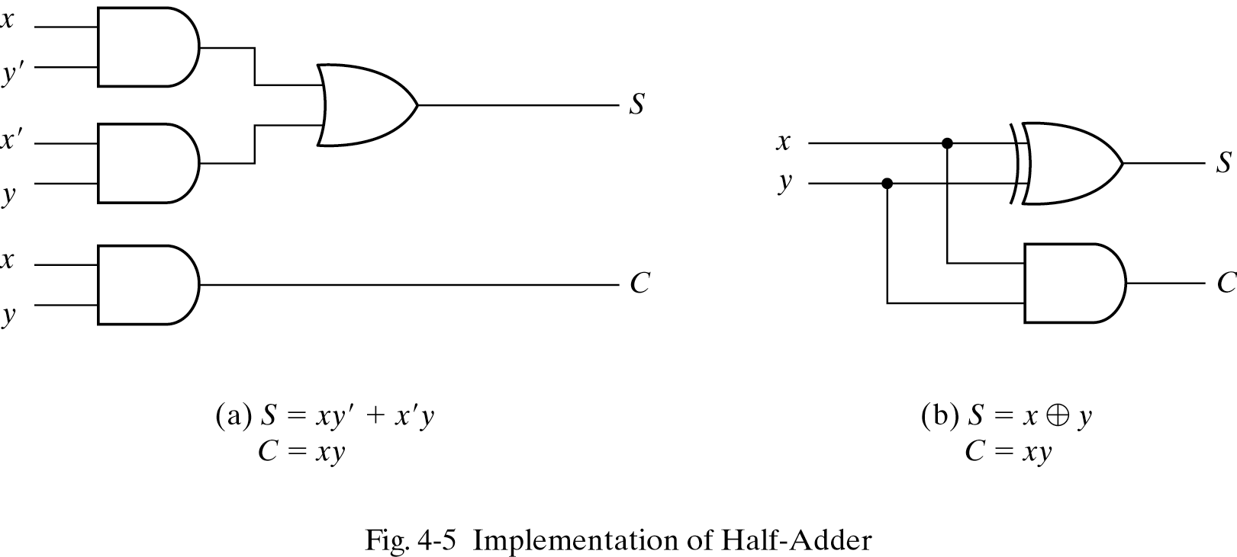
4.5 Binary adder-subtractor - Half Adder

Slide 15
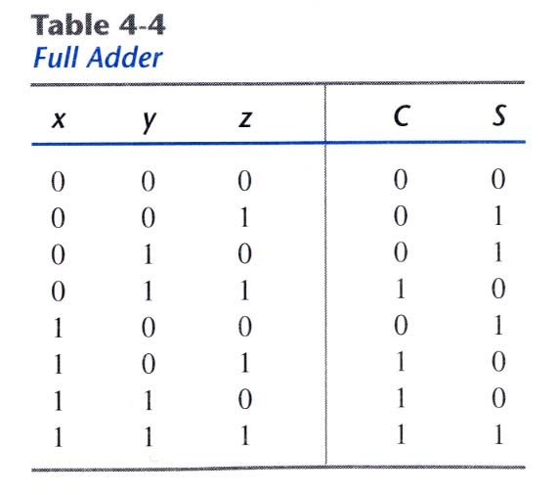
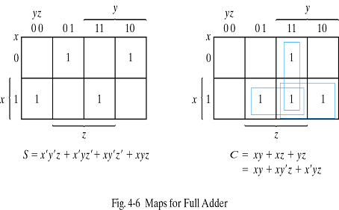
4.5 Binary adder-subtractor - Full adder
Sum of 3 binary inputs
Input : X,Y(2 significant bits),Z(1 carry bit)
Output : S(sum),C(carry)

Slide 16
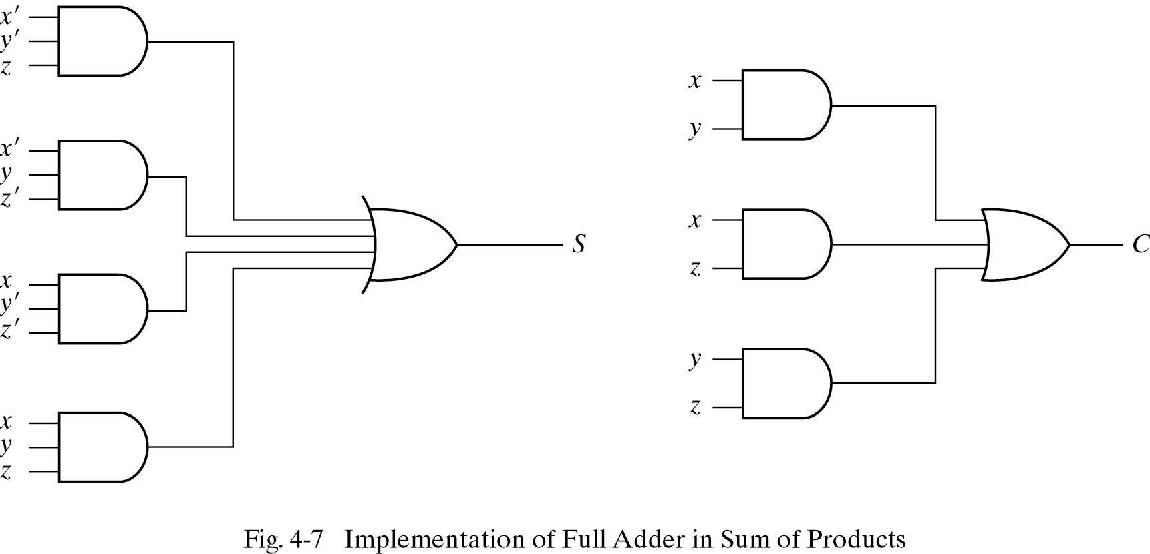
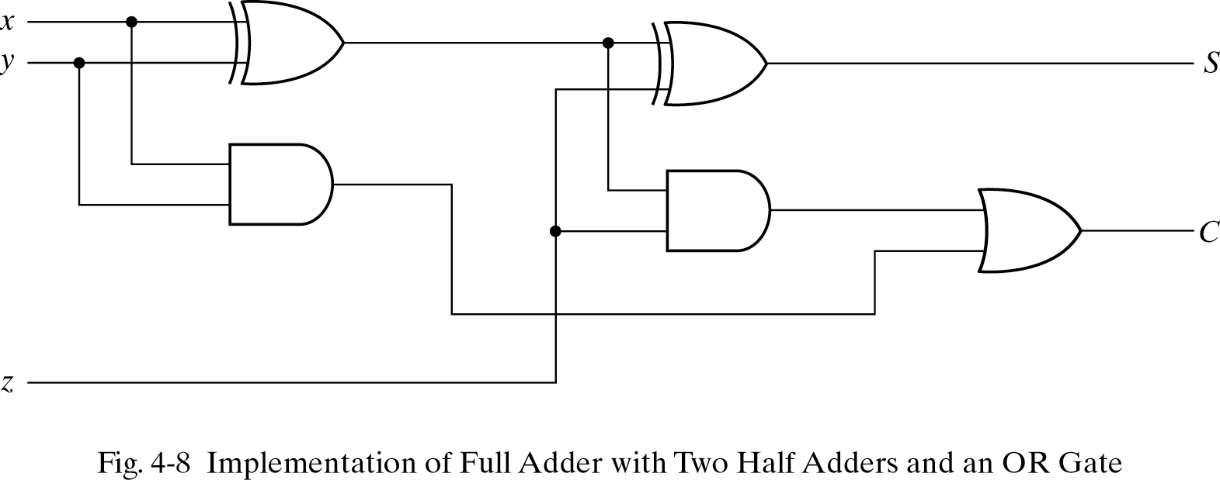
4.5 Binary adder-subtractor - Full adder

Slide 17
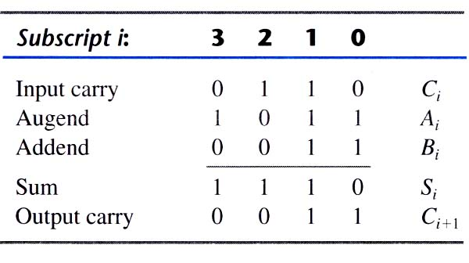
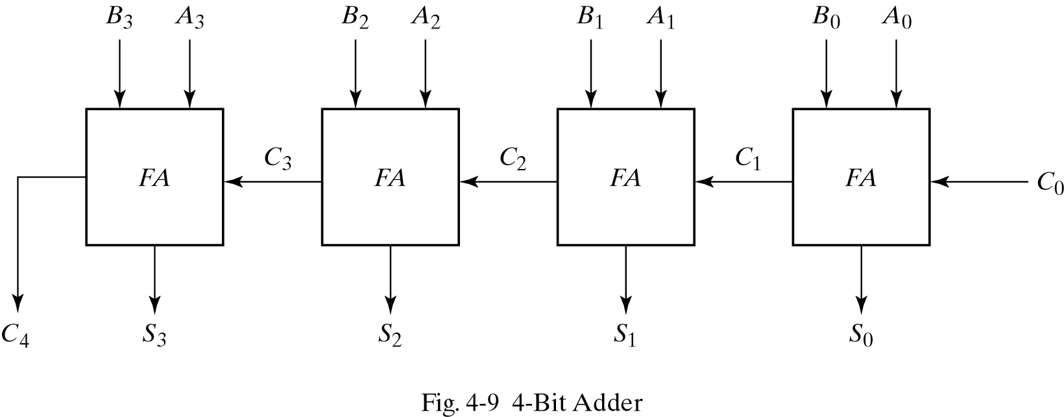
4.5 Binary adder-subtractor - Binary adder
Sum of two n-bit binary numbers
  4-bit adder
  A=1011, B=0011

Slide 18
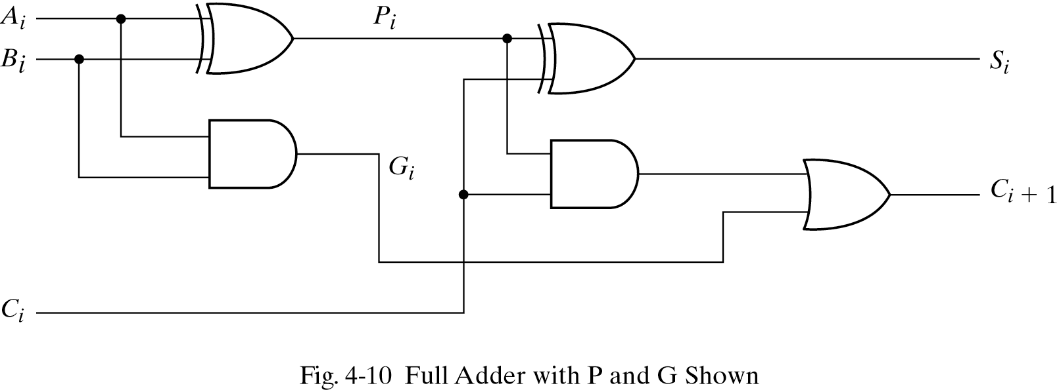
4.5 Binary adder-subtractor - Carry propagation
Rising of delay time(carry delay)
One solution is carry lookahead
All carry is a function of Pi,Gi and C0

Slide 19
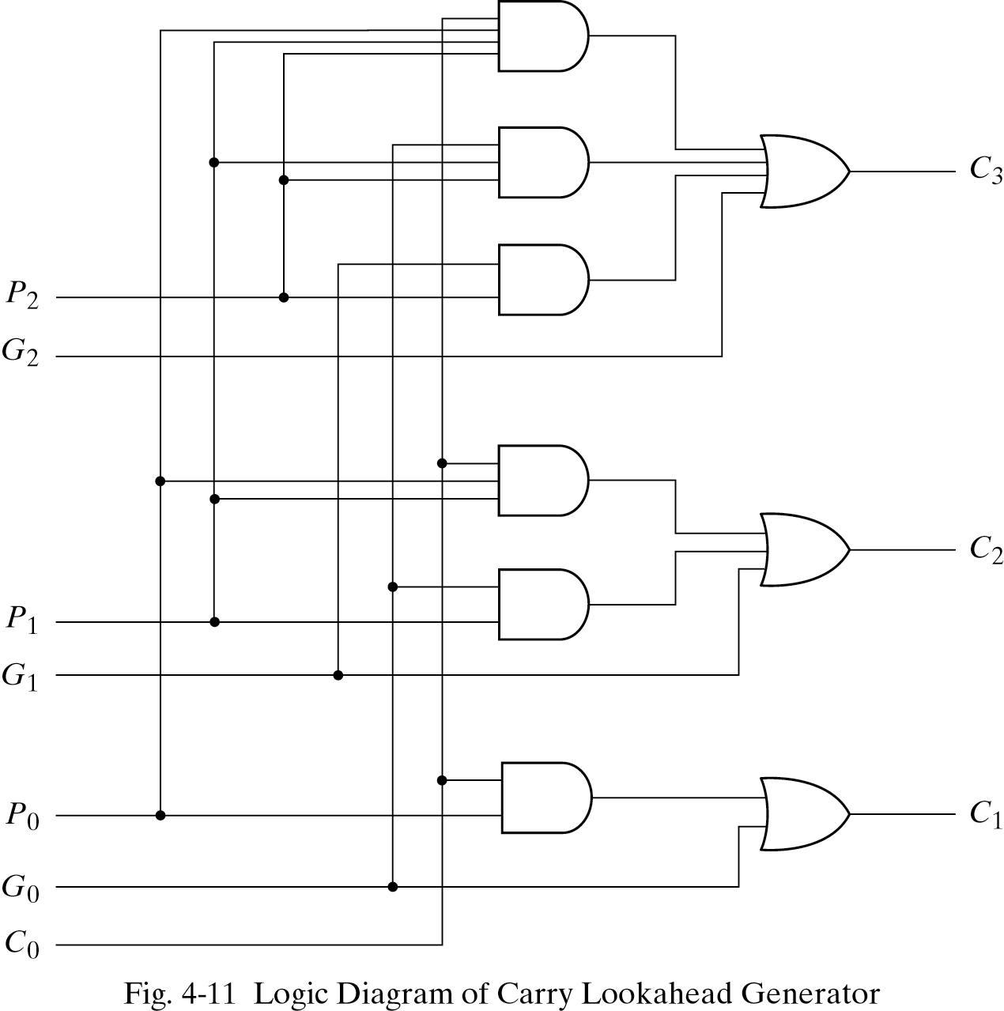
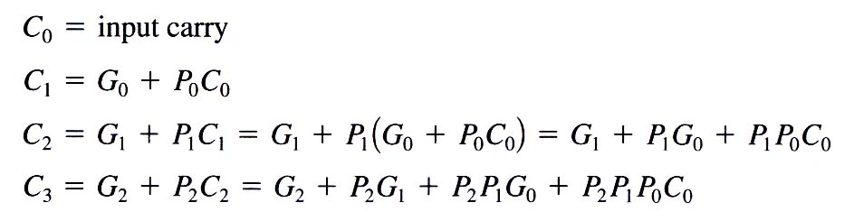
4.5 Binary adder-subtractor - Carry propagation
Carry lookahead generator

Slide 20
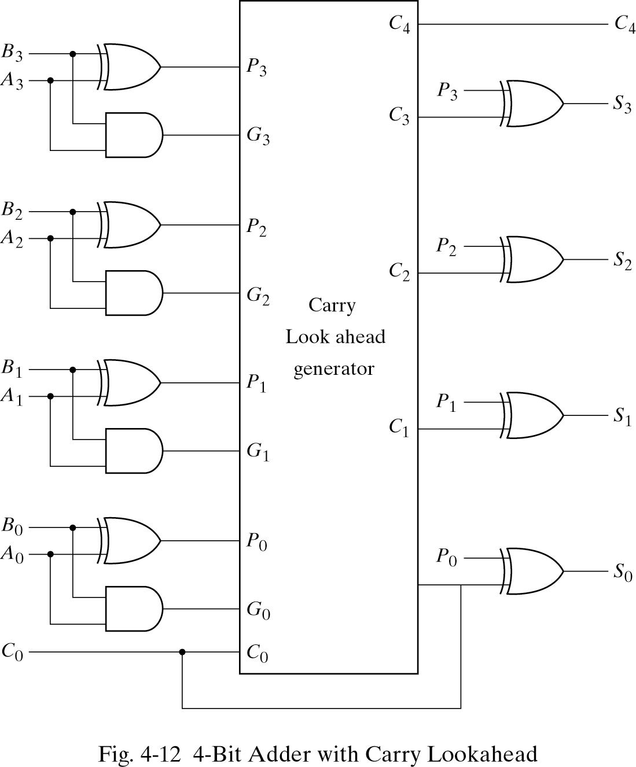
4.5 Binary adder-subtractor - Carry propagation
4-bit adder with carry lookahead

Slide 21
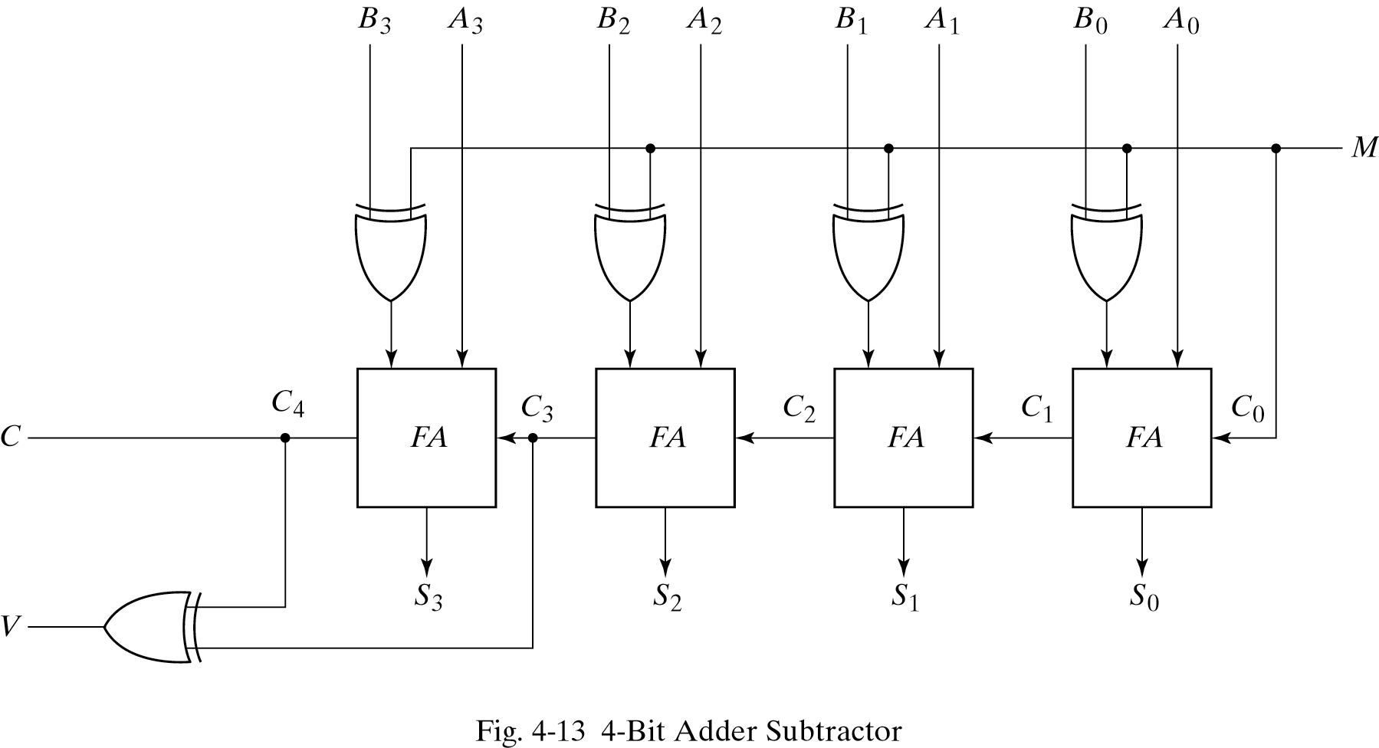
4.5 Binary adder-subtractor - Binary subtractor
A-B equals A+(2’complement of B)
When M=0(act as adder) M=1(subtractor)

Slide 22
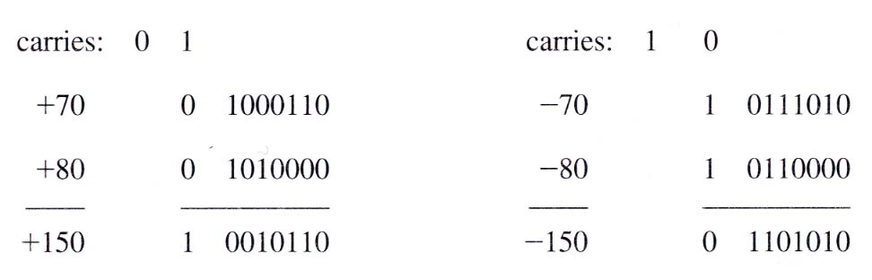
4.5 Binary adder-subtractor - Overflow
Sum of n digit number occupies n+1digit
Occurs when two numbers are same sign
(examples of overflow)

Slide 23
4.6 Decimal adder
Calculate binary and represent decimal in binary coded form
Decimal adder for the BCD code

Slide 24
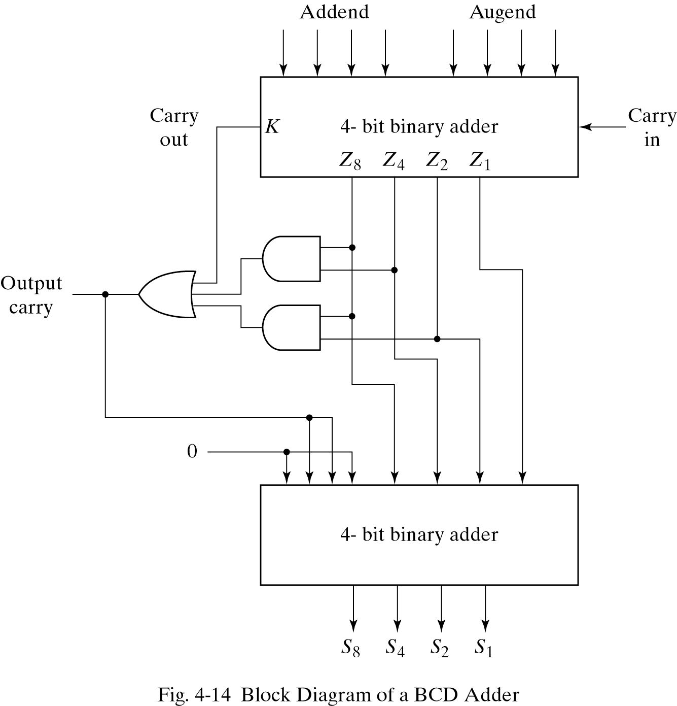
4.6 Decimal adder - BCD Adder
BCD digit output of 2-BCD digit sum
Carry arise if output 1010~1111
C=K+Z8Z4+Z8Z2
1100
1101
1110
1111
1010
1011

Slide 25
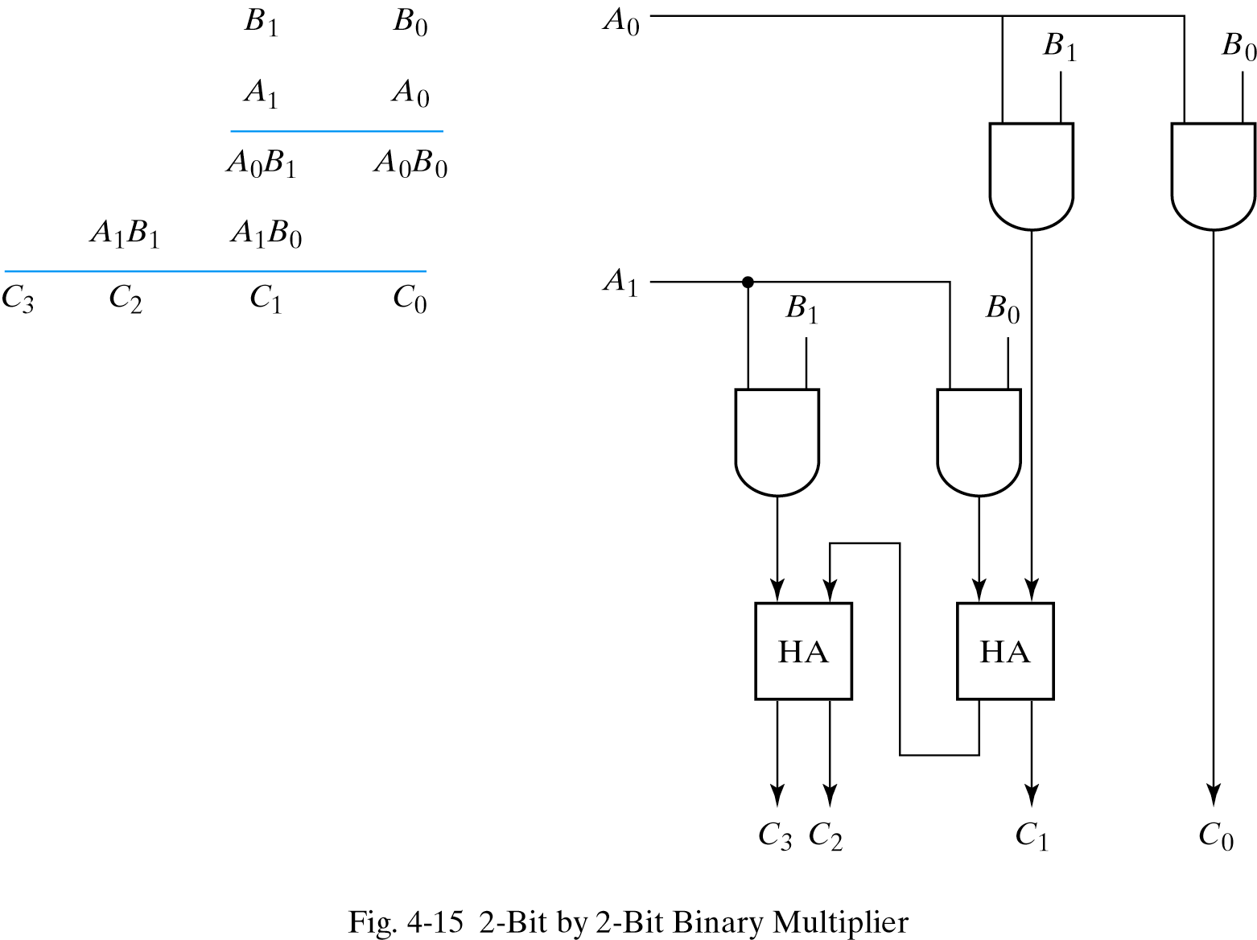
4.7 Binary multiplier
2bit x 2bit = 4bit(max)

Slide 26
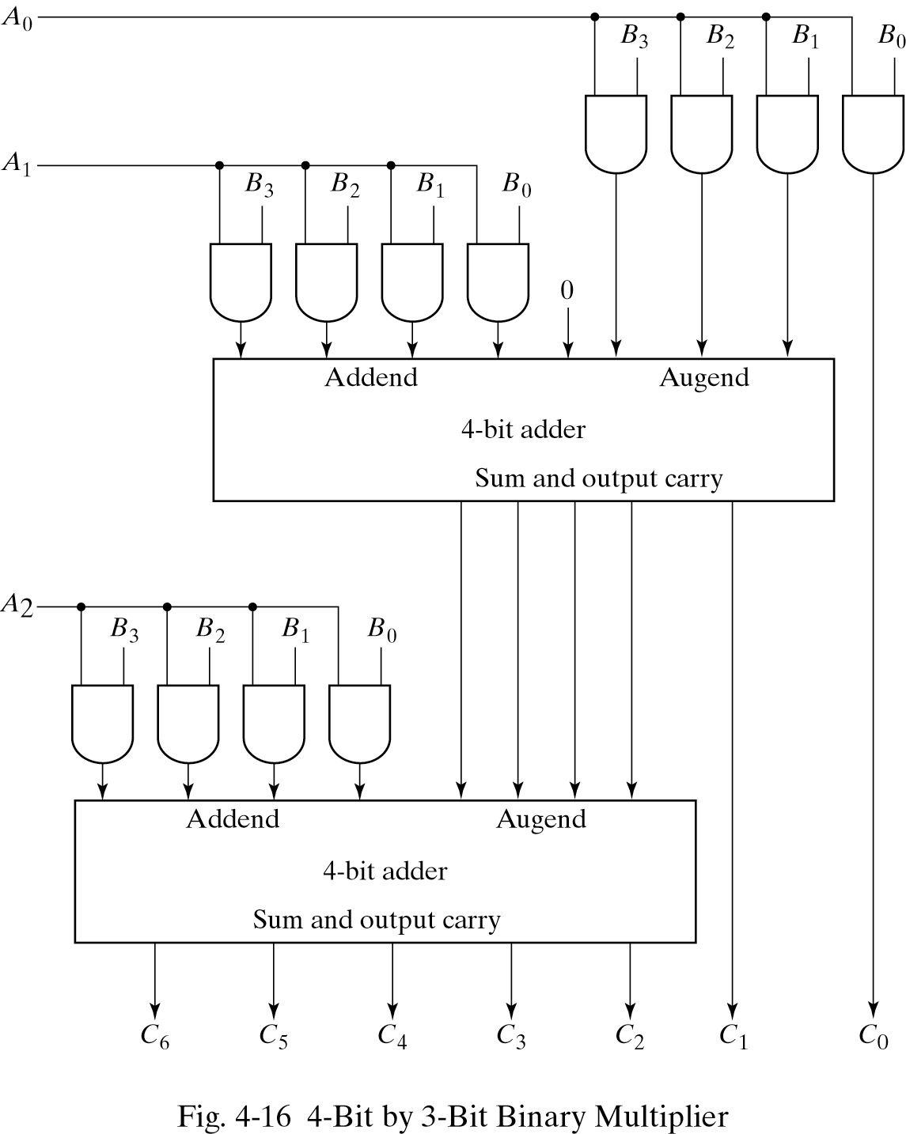
4.7 Binary multiplier
(K-bit) x (J-bit)
  (K x J) AND gates,
  (J-1) K-bit adder needed
  B3B2B1B0
  x A2A1A0

Slide 27
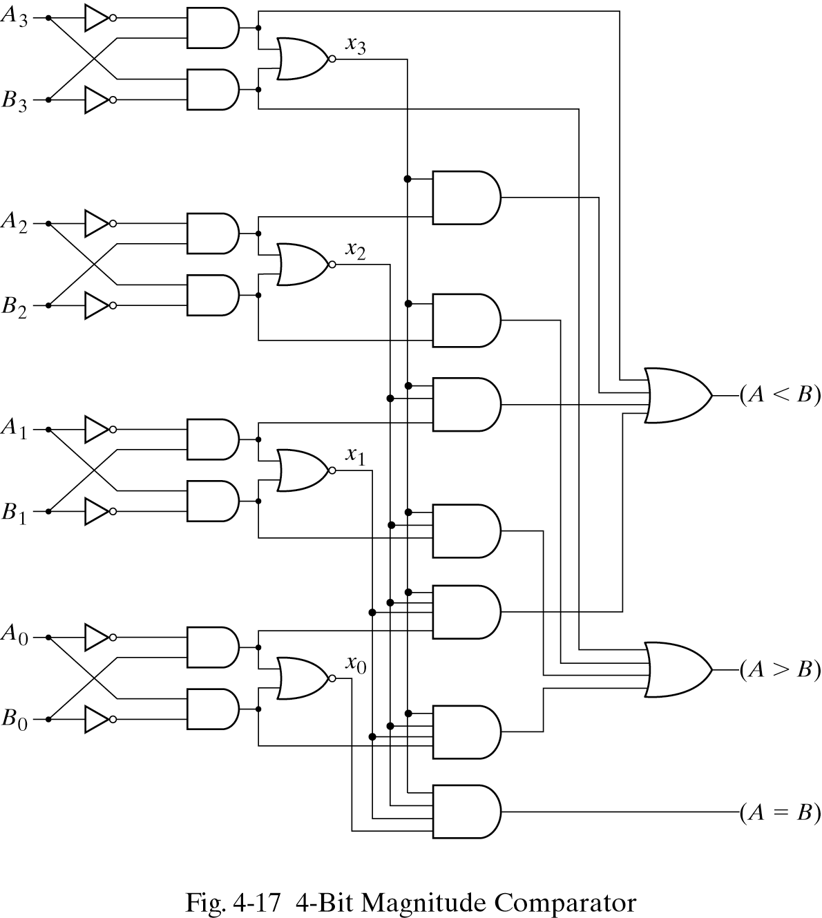
4.8 Magnitude comparator
Xi=1only if the pair of bits in i are equal
(A=B)=x3x2x1x0
(A>B)=A3B3′+x3A2B2′+x3x2A1B1′+x3x2x1A0B0′
(A<B)=A3′B3+x3A2′B2+x3x2A1′B1+x3x2x1A0′B0

Slide 28
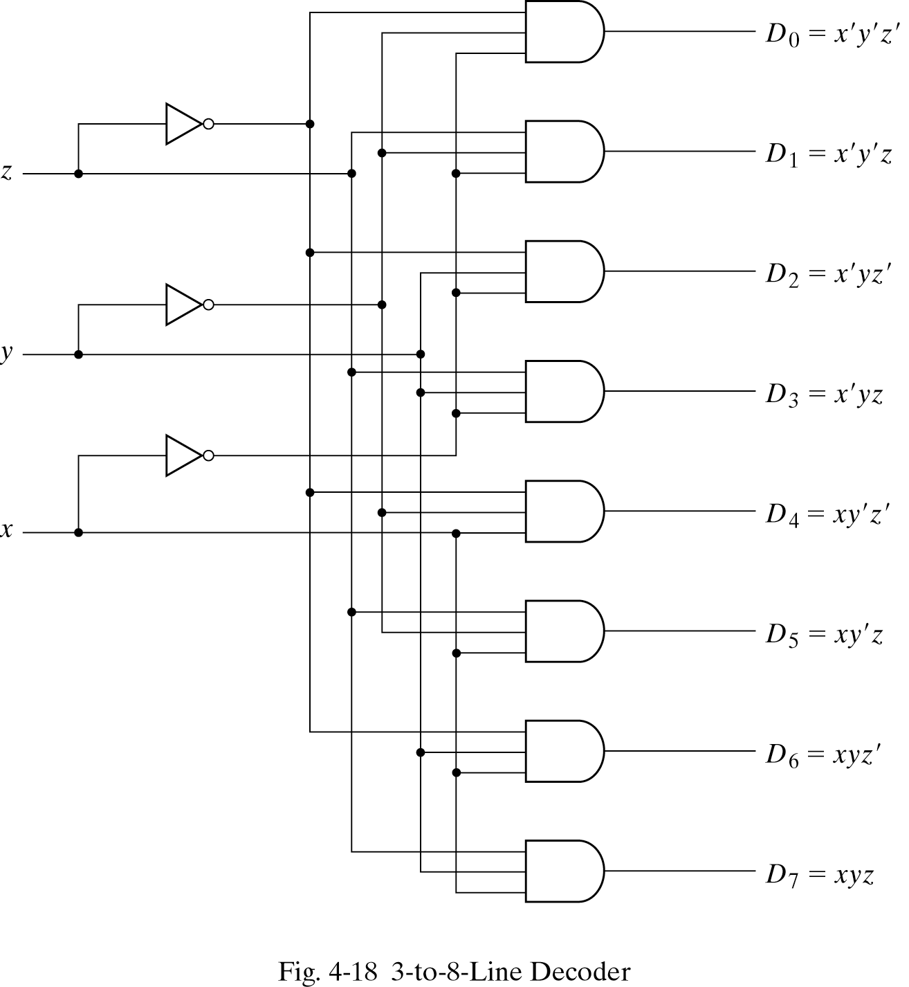
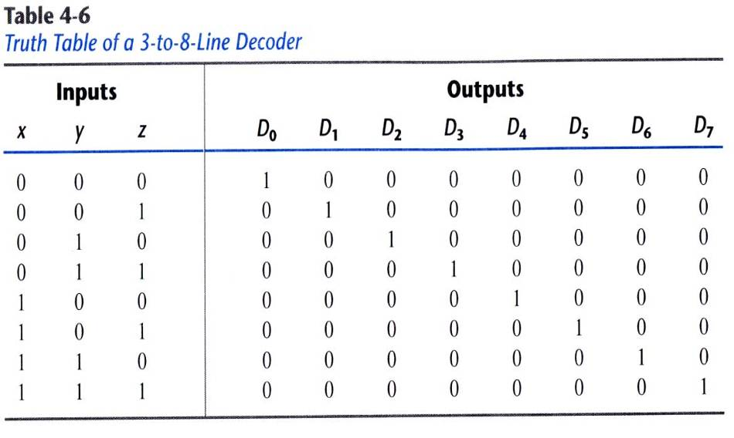
4.9 Decoders
Generate the 2ⁿ(or less) minterms of n input variables
  Eg)3 to 8 line decoder

Slide 29
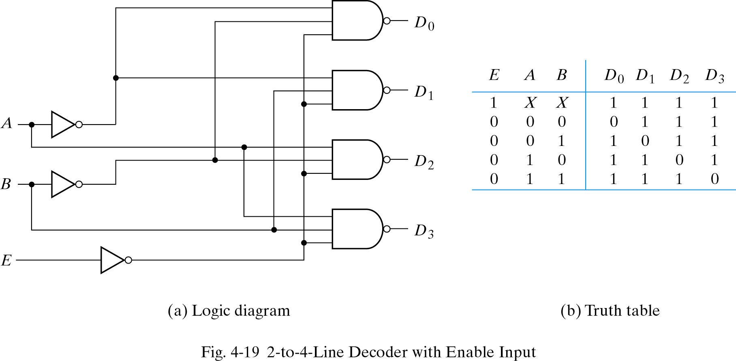
4.9 Decoders
2 to 4 line decoder with Enable input
  Control circuit operation by E

Slide 30
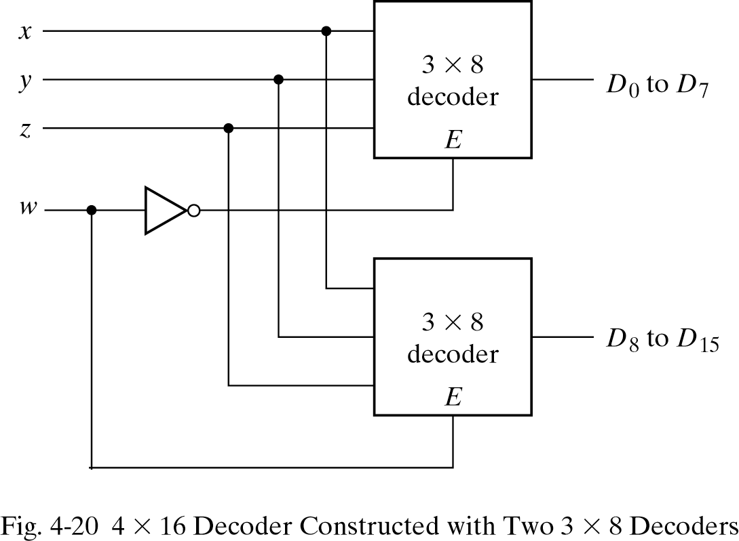
4.9 Decoders
Decoders with enable inputs can be a larger decoder circuit
Eg)4x16 decoder by two 3x8 decoders

Slide 31
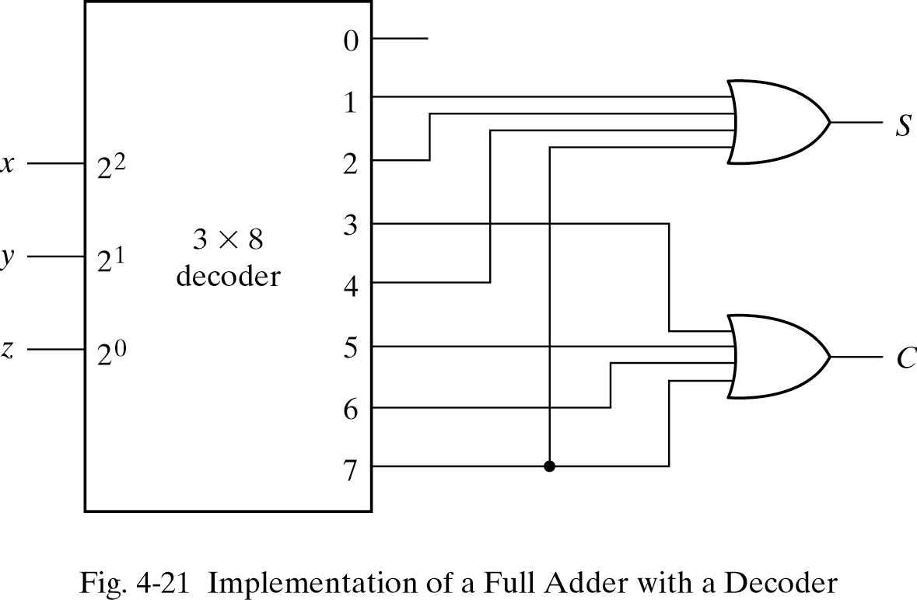
4.9 Decoders - Combinational logic implementation
Combinational logic implementation
  Any combinational circuit can be implemented with line decoder and OR gates
  Eg)full adder

Slide 32
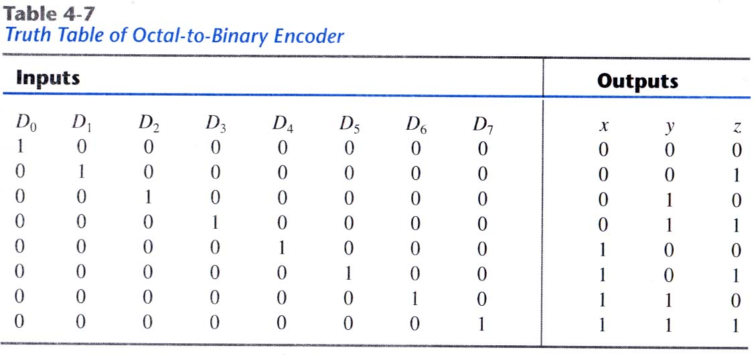
4.10 Encoders
Inverse operation of a decoder
Generate n outputs of 2ⁿ input values
  Eg) octal to binary encoder

Slide 33
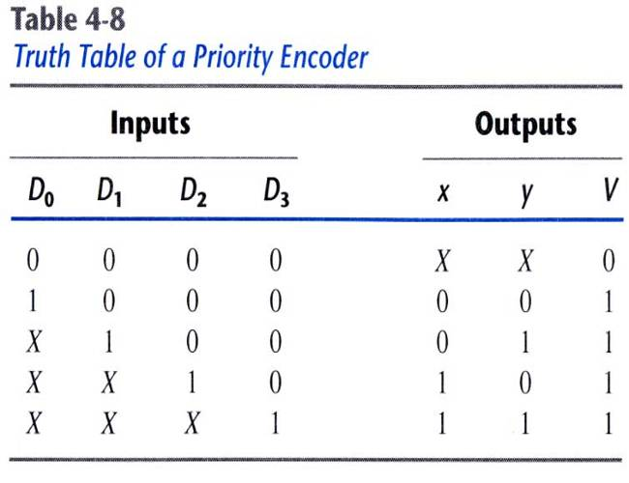
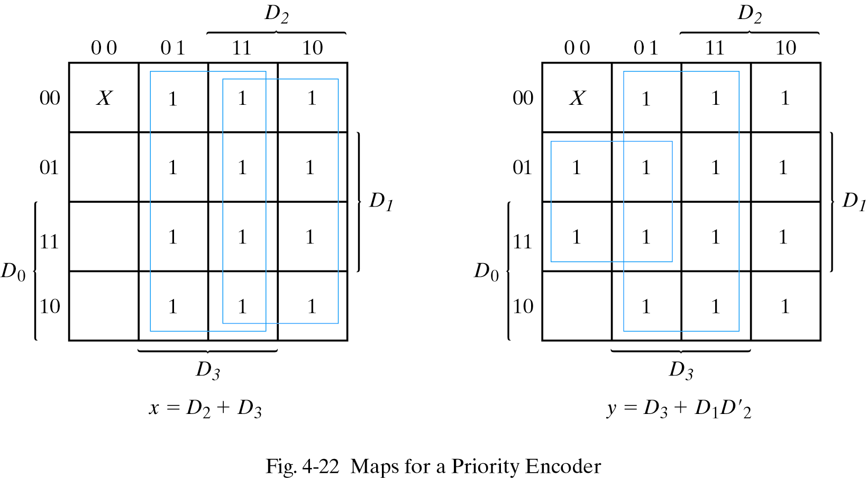
4.10 Encoders - Priority encoder
Problem happens two or more inputs equal to 1 at the same time
Give a priority function to circuit
(x100 means 0100, 1100)

Slide 34
4.11 Multiplexers
Select a binary information from many input lines
Selection is controlled by a set of selection lines
2ⁿ input lines have n selection lines

Slide 35
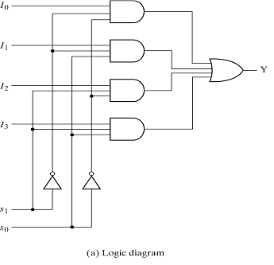
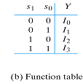
4.11 Multiplexers
4 to 1 line multiplexer

Slide 36
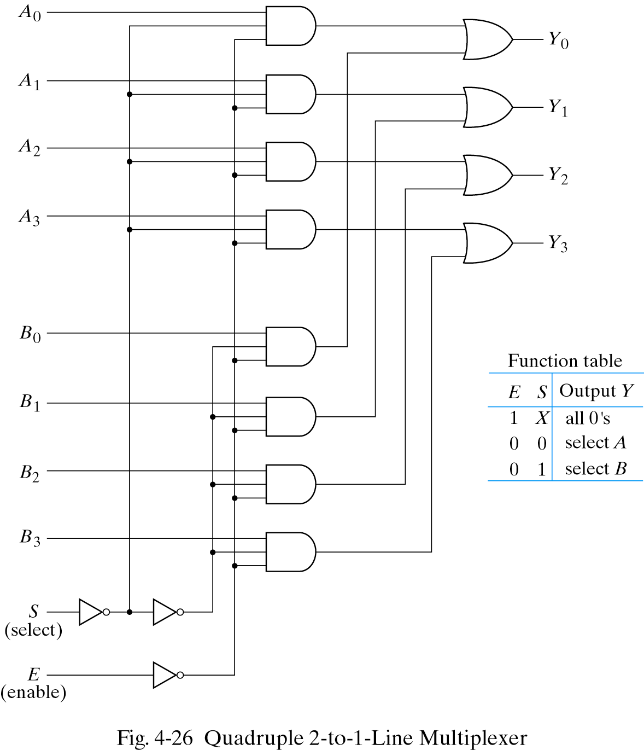
4.11 Multiplexers
Quadruple 2 to 1
line multiplexer

Slide 37
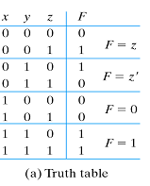
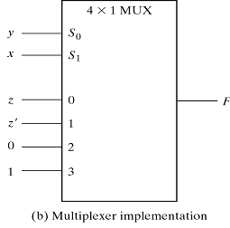
4.11 Multiplexers - Boolean function implementation
Boolean function implementation
  Minterms of function are generated in a MUX
  n input variables, n-1 selection input
F=xy+yz′+x′y′z

Slide 38
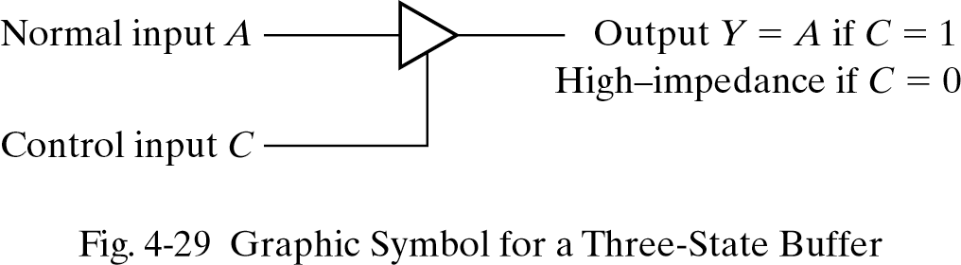
4.11 Multiplexers - Three-state gates
Three-state gates
  Logic 1, 0 and high-impedance
  High-impedance behaves like an open circuit

Slide 39
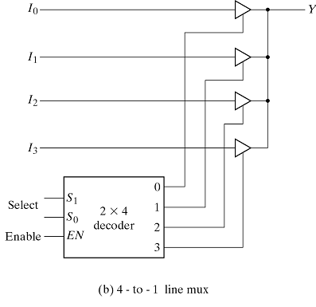
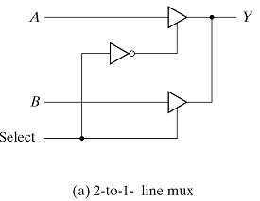
4.11 Multiplexers
Multiplexers with three-state gates

Slide 40
4.12 HDL for combinational circuit
Modeling techniques:
  Gate level modeling
    Instantiation of gates and user defined modules
  Dataflow modeling
    Using continuous assignment statements-assign
  Behavioral modeling
    Using procedural assignment statements-always

Slide 41
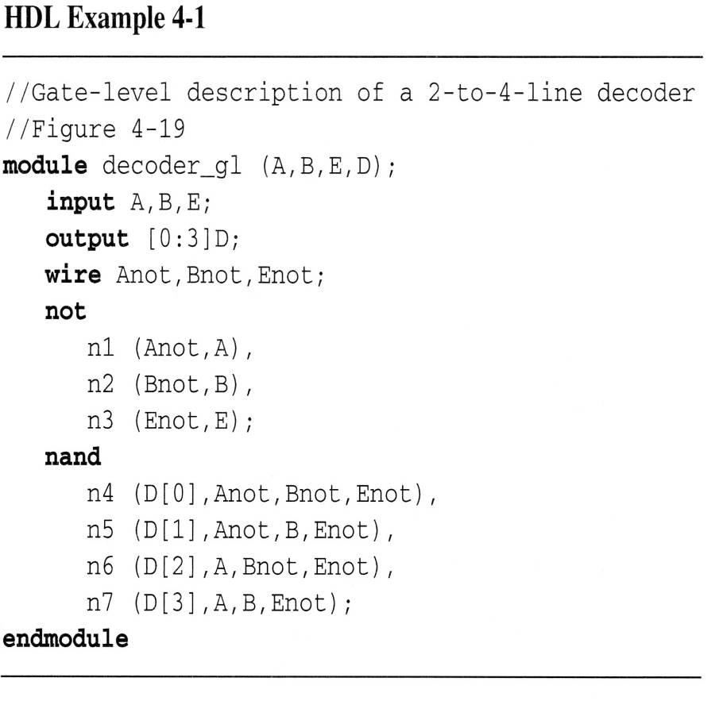
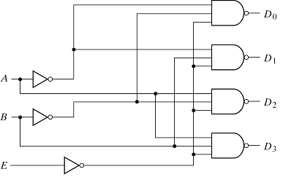
4.12 HDL for combinational circuit - Gate-level modeling
Circuit is specified by its gates and their interconnection

Slide 42
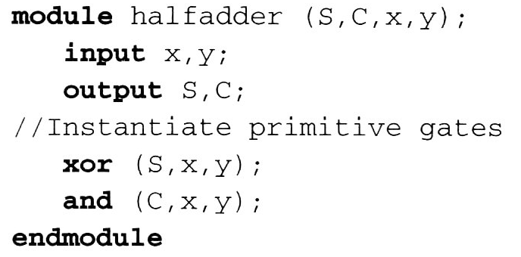
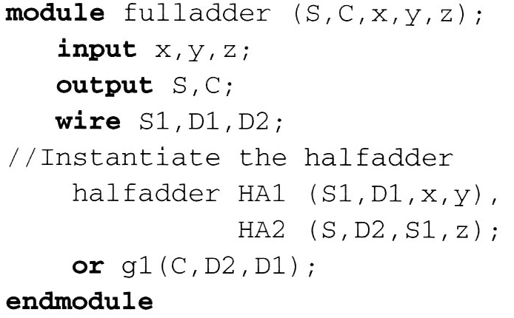
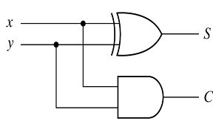
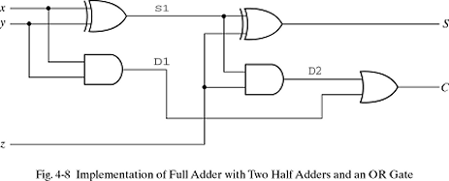
4.12 HDL for combinational circuit - Gate-level modeling
Instantiation

Slide 43
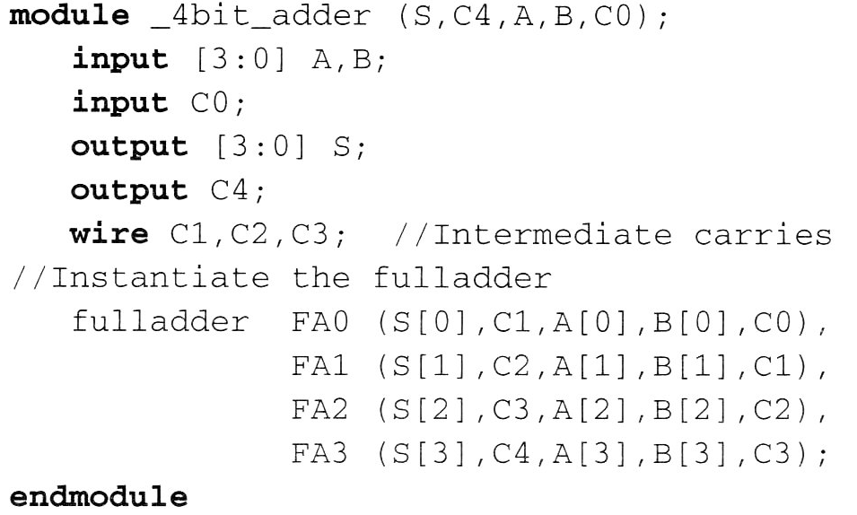
4.12 HDL for combinational circuit - Gate-level modeling
Instantiation in 4-bit adder

Slide 44
4.12 HDL for combinational circuit - 3 State Gate

Slide 45
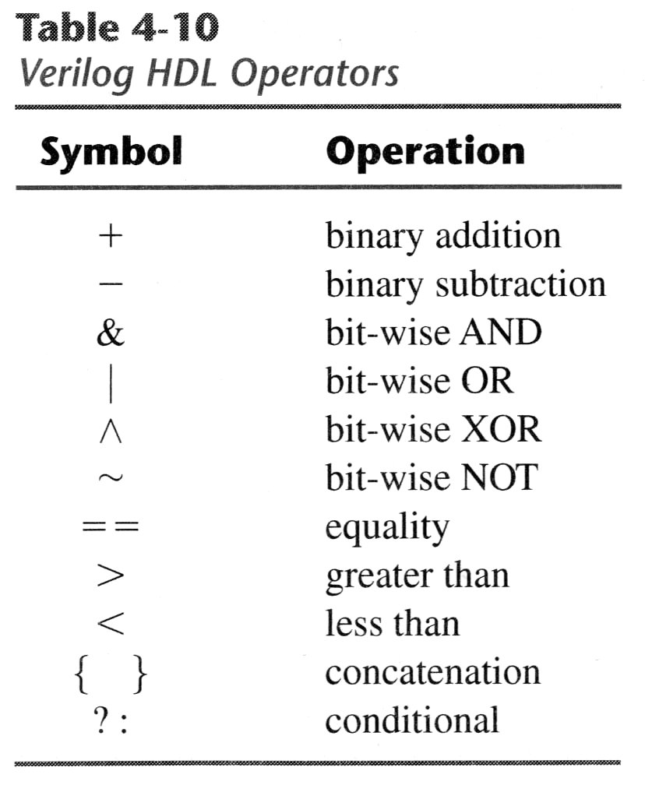
4.12 HDL for combinational circuit - Dataflow modeling
Assign a value to a net by using operands and operators
eg)J=01,K=10 can be
{J,K}=0110
out=x ? A : B means
out=A, if x is true
=B, if x is false

Slide 46
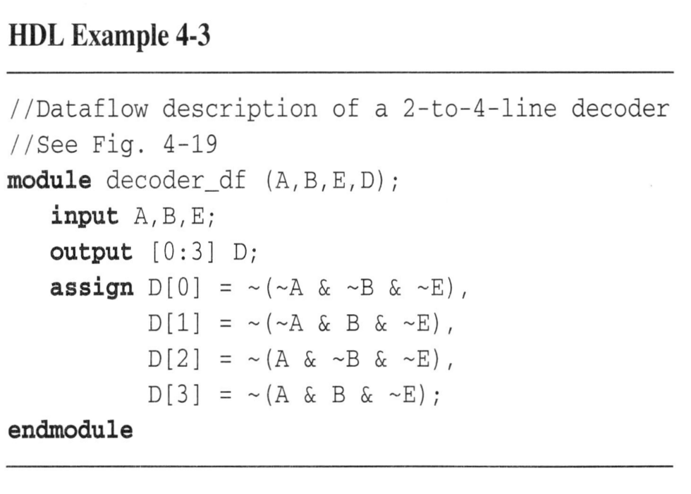
4.12 HDL for combinational circuit - Dataflow modeling
Assignment
- 2-to-4 line decoder

Slide 47

4.12 HDL for combinational circuit - Dataflow modeling
Assignment
- 4-bit adder

Slide 48

4.12 HDL for combinational circuit - Behavioral modeling
Use procedural assignment statement, always
Target output must be the reg data type
Eg)4 to 1 line mux

Slide 49

4.12 HDL for combinational circuit - Writing a simple test bench
Test bench : Applying stimulus to test HDL
and observe its response
reg - inputs , wire - outputs

Slide 50
4.12 HDL for combinational circuit - Writing a simple test bench
System tasks : keywords that can display various outputs (begin with $)
$display , $write , $monitor , $time , $finish
Format of system tasks
  Task name(format specification,argument list);
  Eg) $monitor(%d %b %b, C,A,B);

Slide 51



4.12 HDL for combinational circuit - Writing a simple test bench
Example of test bench

